Slide 1

Gemini PDF Q&A Processor
AI-powered automated question answering system transforming PDF processing with intelligent diagram generation and professional reporting capabilities.

Slide 2
The Challenge We're Solving
Current Pain Points
Our Innovative Solution
Manual PDF question processing consumes valuable time and resources
Automated AI-powered processing eliminates manual effort
Traditional Q&A systems lack compelling visual aids
Intelligent diagram generation enhances comprehension
Inconsistent formatting creates confusion and reduces usability
Structured, professional outputs ensure consistency
Limited scalability for large document volumes
Scalable architecture handles high-volume processing

Slide 3





Core Features & Capabilities
AI Integration
Smart Processing
Visual Intelligence
Powered by Gemini 2.5 Flash Lite with multiple API support for robust, intelligent processing.
Automated question extraction and answering with context-aware intelligence.
Mermaid and AI-generated diagrams bring answers to life with clear visualisations.
Professional Outputs
Enhanced UX
Structured PDF reports with embedded diagrams and consistent formatting.
Dark-themed interface with real-time progress tracking for seamless user experience.

Slide 4





Technology Architecture
PDF Upload
Document ingestion and validation
Question Extraction
Intelligent pattern recognition
AI Processing
Gemini API analysis
Answer Generation
Structured responses
Report Export
Professional PDF output
Frontend Stack
Backend Services
Streamlit framework
Google Gemini API
Custom CSS styling
Mermaid.js, HuggingFace, DeepAI
Responsive design
PyPDF2 and FPDF libraries

Slide 5

Intelligent Processing Pipeline
01
02
Smart Question Detection
Answer Generation
Advanced regex pattern matching identifies questions with high accuracy, whilst context-aware extraction ensures relevant content capture and automatic duplicate removal maintains data quality.
Choose between concise or detailed response modes. Structured formatting enhances readability, and built-in quality validation ensures accurate, reliable outputs every time.
03
Diagram Intelligence
The system automatically assesses when diagrams enhance understanding, offering multiple generation options including Mermaid flowcharts and AI-generated infographics.

Slide 6
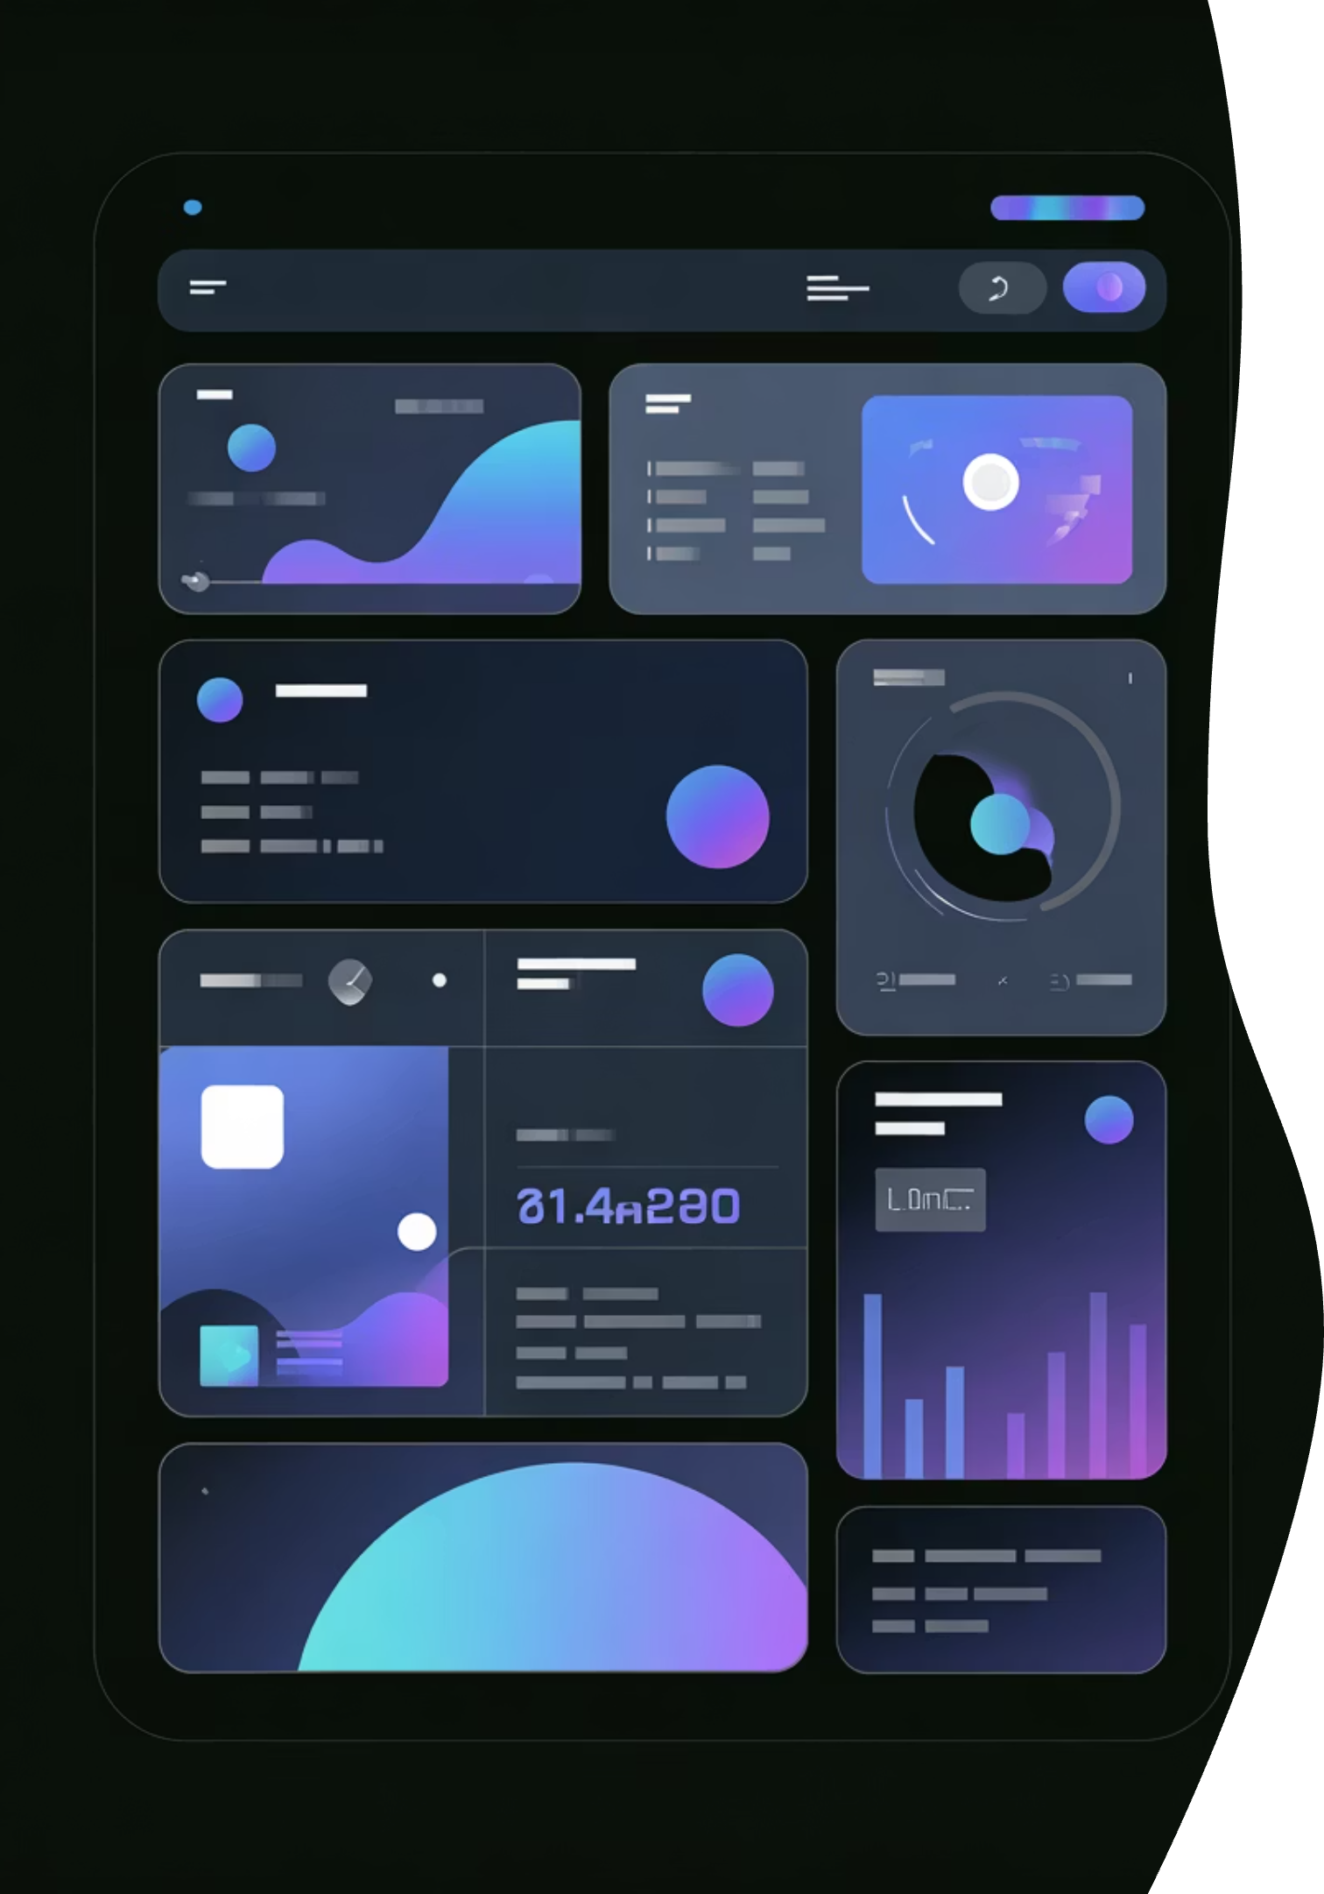
Intuitive User Interface
Sidebar Configuration
Effortless setup with API key management, processing settings, and customisable options all in one convenient location.
Main Processing Area
Streamlined file upload with real-time progress tracking keeps you informed throughout the entire processing workflow.
Results Display
Structured Q&A presentation with embedded diagrams ensures clarity and professional appearance in every output.
Dark Theme Design
Professional gradient styling reduces eye strain whilst maintaining excellent readability for extended usage sessions.

Slide 7

Advanced Diagram Capabilities
Mermaid Diagrams
Technical flowcharts and sequence diagrams
Code-based generation for precision control
Fully editable with multiple export formats
Perfect for technical documentation
AI-Generated Diagrams
Visual infographics and conceptual illustrations
High-quality PNG image format
Multiple service providers ensure reliability
Ideal for non-technical audiences
Smart Detection Technology: The system automatically suggests appropriate diagram types based on content analysis, ensuring optimal visual communication for each answer.

Slide 8

Professional PDF Reporting
Comprehensive Features
Quality Assurance
Structured Q&A format with clear hierarchy
Robust text encoding handling
Seamlessly embedded diagram images
Intelligent image compression
Professional headers and footers
Consistent styling throughout
Cross-platform compatibility guaranteed
Error-free generation process

Slide 9





Real-World Applications
Education
Corporate Training
Research
Automated question banks and study materials generation streamline course preparation and student assessment workflows.
Transform training documentation and knowledge bases into interactive Q&A resources for efficient employee onboarding.
Analyse academic papers and technical documentation with AI-powered comprehension and visual summaries.
Publishing
Competitive Exams
Accelerate content creation for educational materials with automated question generation and professional formatting.
Generate comprehensive practice question sets with detailed explanations and supporting visual aids for test preparation.

Slide 10

Future Vision & Next Steps
1
Q1 2024
Additional AI model support and enhanced diagram types
2
Q2 2024
Collaboration features and team workspace capabilities
3
Q3 2024
Mobile application launch for iOS and Android platforms
4
Q4 2024
Enterprise integration and advanced analytics dashboard
Experience the Future
Transform your PDF Q&A processing with intelligent automation, compelling visualisations, and professional outputs. Ready to revolutionise how you work with documents?

